Slide 1
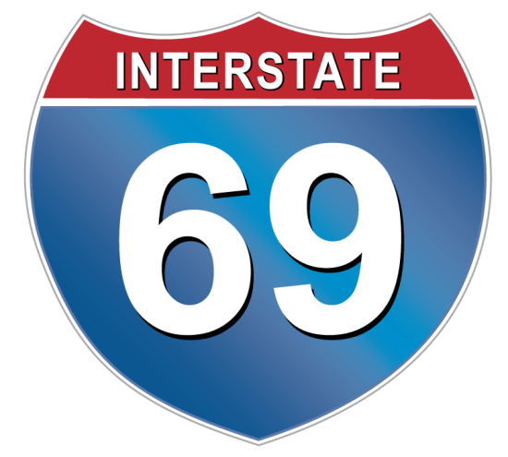
I-69 Congressional Caucus Briefing
A Freight Corridor Connecting the American Heartland
April 22, 2015
I-69 DC Fly-In 2015
Delegation Representing the 8-State Corridor

Slide 2
Texas

Slide 3


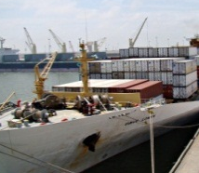
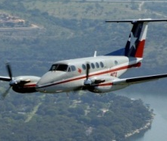
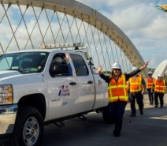
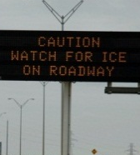
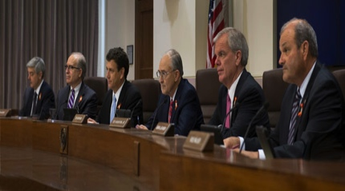
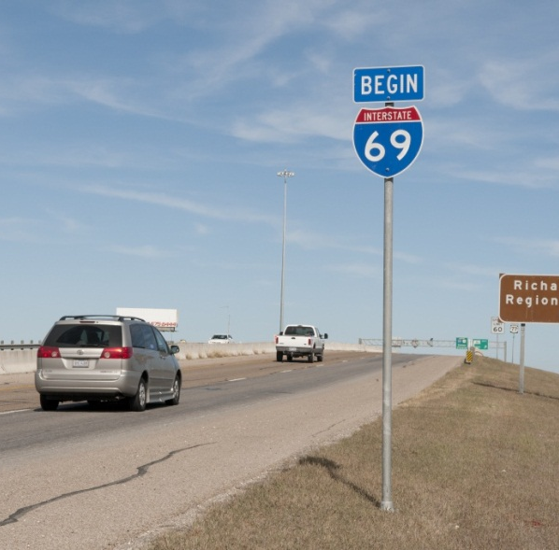
Texas Department of Transportation
I-69 UPDATE
Commissioner Jeff Austin, III
Commissioner Jeff Moseley

Slide 4
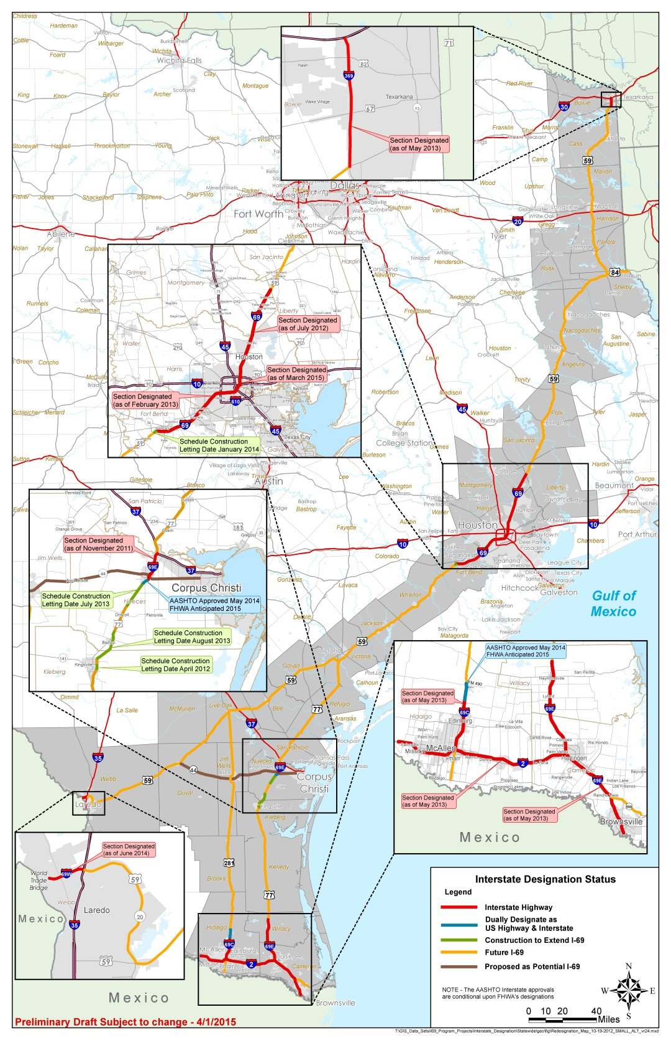
Interstate Designation Status

Slide 5
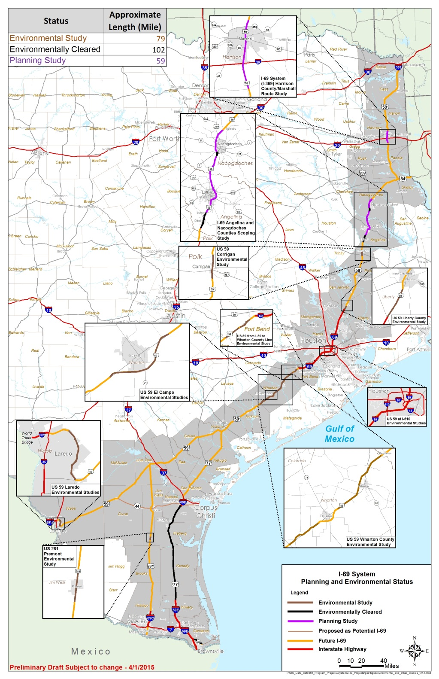
Planning and Environmental

Slide 6
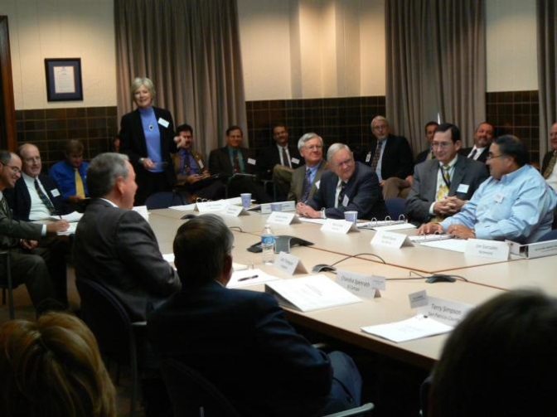
I-69 Funding Program
In 2012, the five Segment Committees identified over $16 billion of recommended improvements for the roadways they want to serve as I-69 Texas
However, there is limited funding from federal and state programs, which are subject to congressional and legislative actions
In 2012, the I-69 Advisory Committee recommended innovative funding and project development strategies such as
tolling,
tax-increment financing,
public private partnership agreements, and
partnerships with local governments

Slide 7
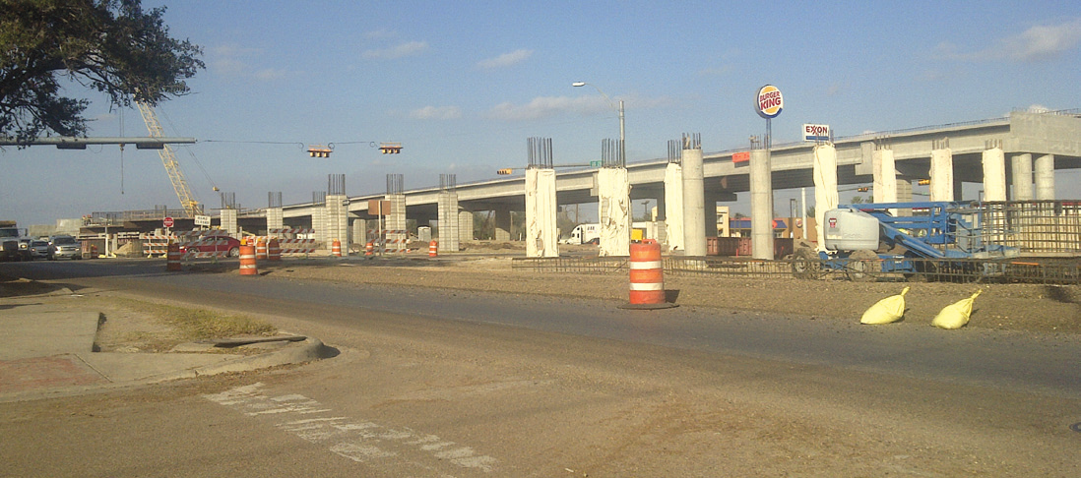
I-69 Development Expenditures
Expenditures on I-69 Development Since September 1, 2010
$76,782,479 Project Development (planning, environmental, design)
$304,199,169 Funded Construction (not yet started)
$957,160,356 Constructed/Under Construction
Total to date $1,338,142,004

Slide 8
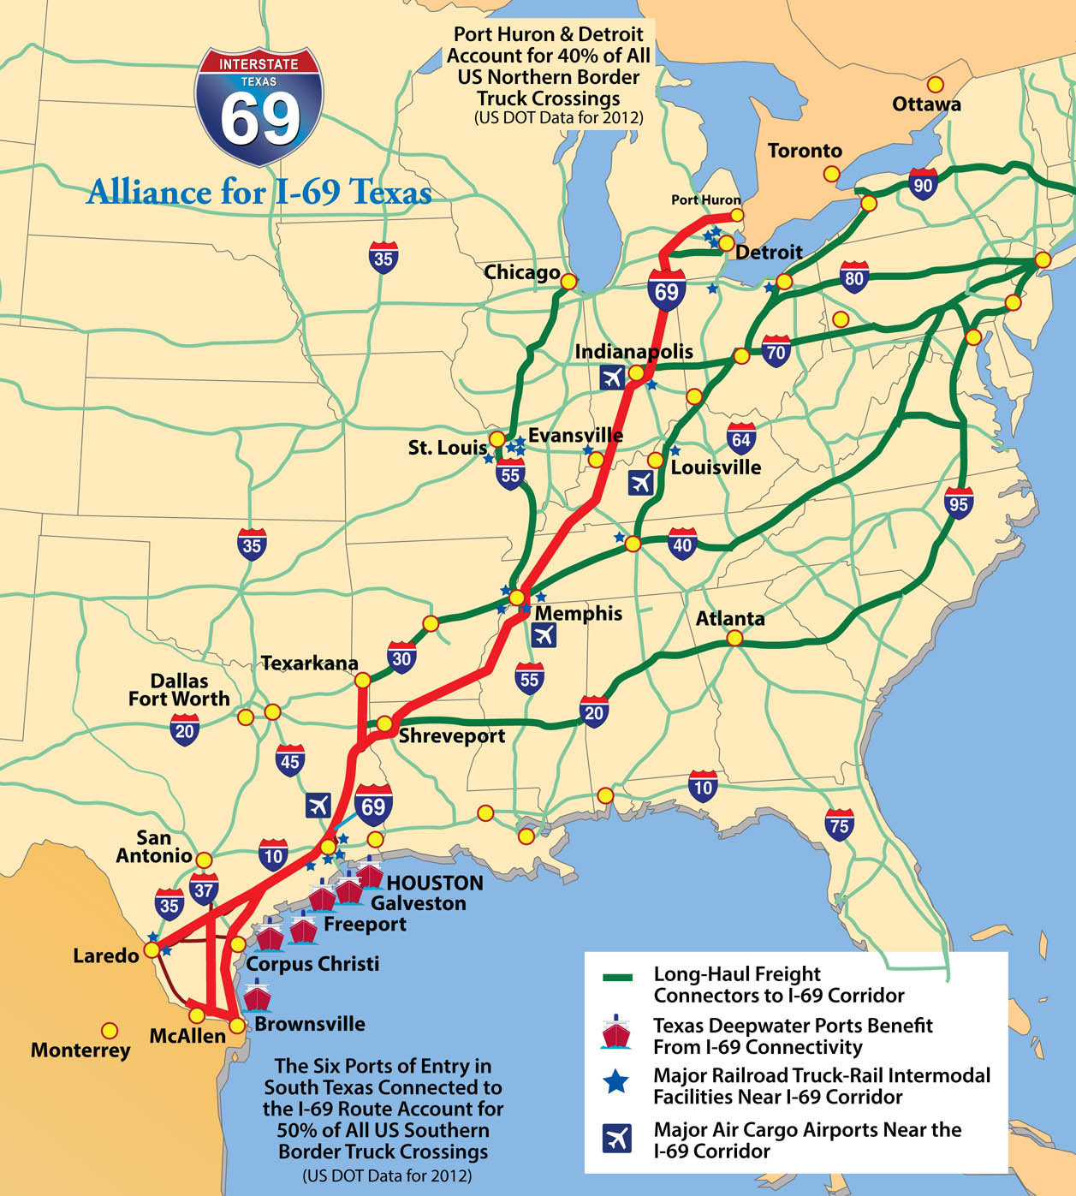
I-69 and Freight

Slide 9
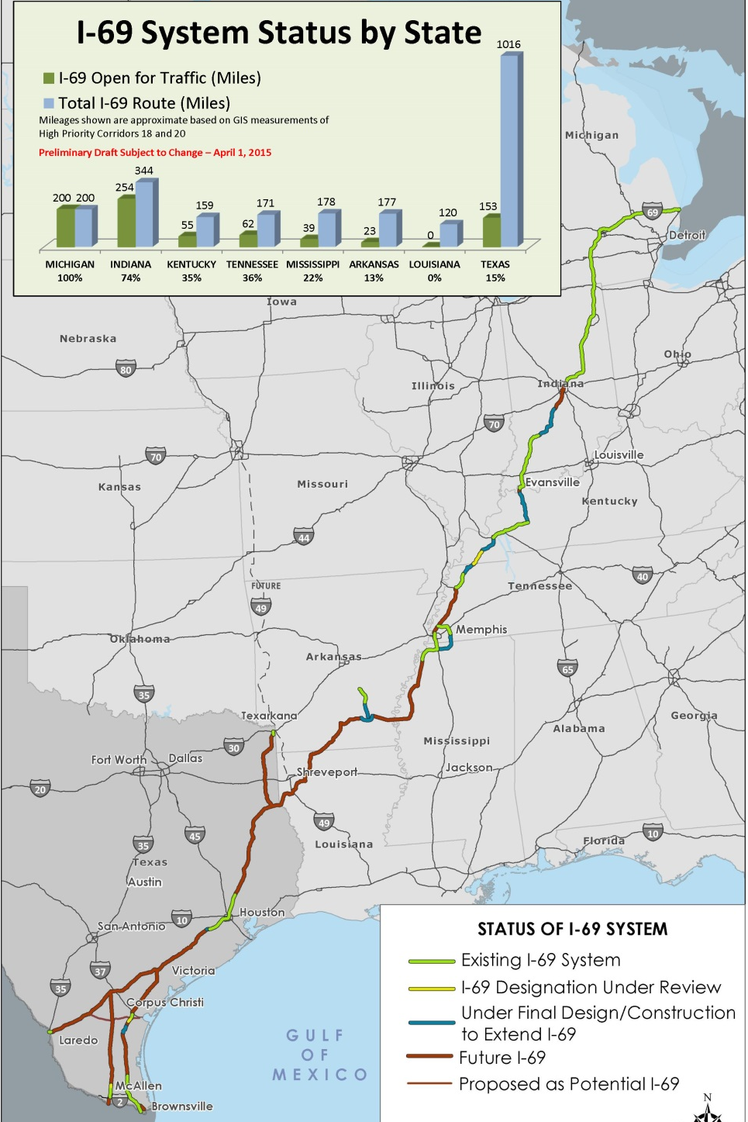
National Status 2015

Slide 10
Louisiana

Slide 11
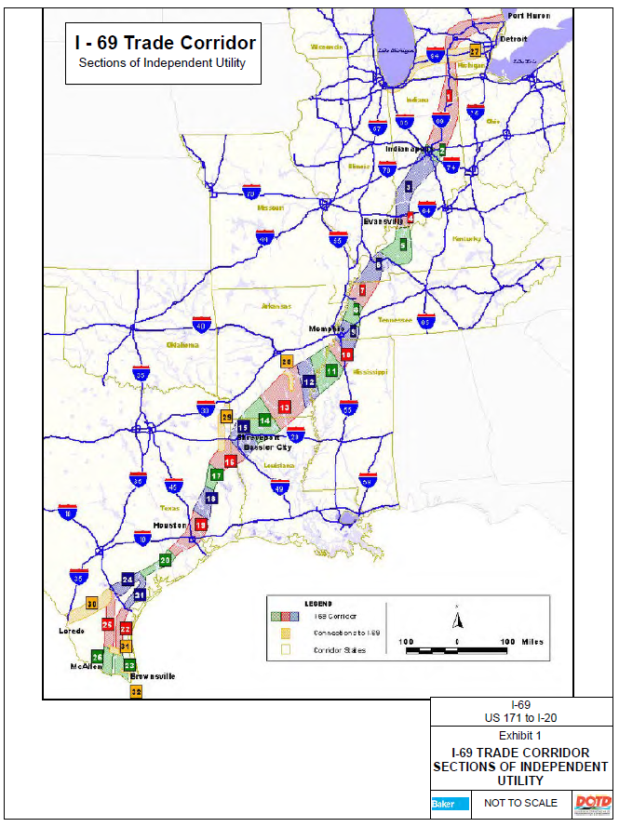

Slide 12
Section of Independent Utility (SIU) 14 El Dorado, AR – Haughton, LA
Environmental Impact Statement (EIS), Record of Decision (ROD) signed April 27, 2012
Preferred Alternative Alignment Mileage:
Arkansas 30 miles (approx.)
Louisiana 40 miles (approx..)
70 miles total
Estimated Cost to build:
Arkansas $475 Million (2011$)
Louisiana $778 Million (2011$)
$1.253 Billion
See attached Preferred Alternative map from ROD document
LA DOTD has agreed to use existing federal earmark funds for the Shreveport MPO to develop a corridor preservation plan for the Louisiana portion of SIU 14

Slide 13
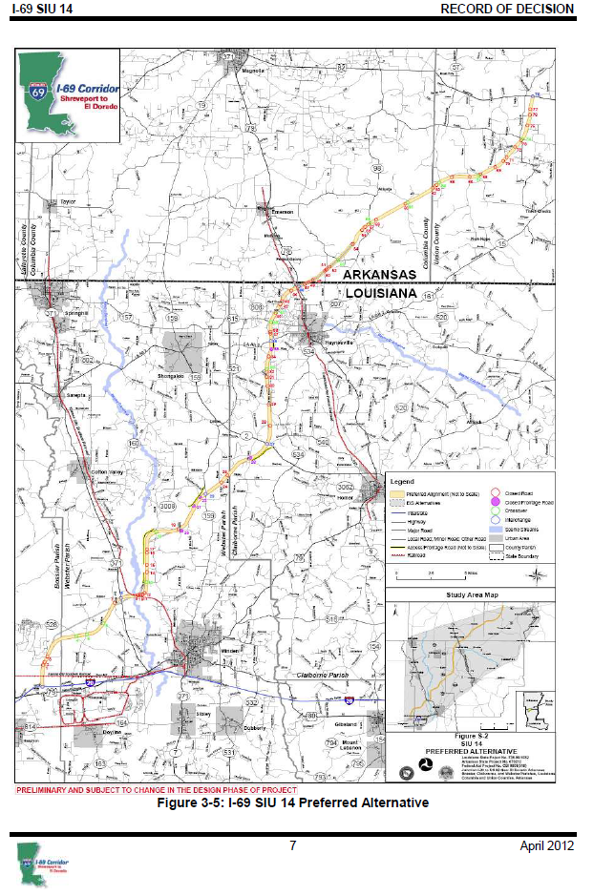
I-69 SIU 14

Slide 14
Section of Independent Utility (SIU) 15 Haughton, LA – Stonewall, LA
Environmental Impact Statement (EIS), Record of Decision (ROD) signed August 28, 2014
Selected Alignment Mileage: 35.6 miles
Estimated Cost to build: $1.170 Billion
See attached Selected Alignment map from ROD document
LA DOTD has agreed to use existing federal earmark funds for the Shreveport MPO to develop a corridor preservation plan for SIU 15

Slide 15
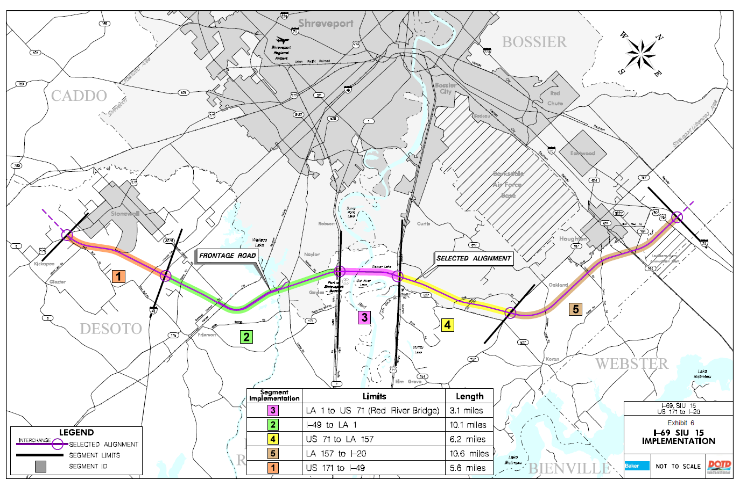
I-69 SIU 15

Slide 16
Section of Independent Utility (SIU) 16 Tenaha TX – Stonewall LA
TxDOT is lead agency for formal NEPA Process, under TX/LA Agreement, May 10, 2002
NEPA process not complete for SIU 16
SIU 16 is part of Texas I-69 Segment One – Alternate US 84 Route to TX/LA border

Slide 17
Planned activities/status – I-69 in Louisiana
Focus on the Red River Bridge segment (LA 1 to US 71) of SIU 15 – estimated cost: $340 (+) Million
Approx. $12 Million remaining in I-69 Federal Earmark funds for I-69 in LA
At approx. total cost of $2 Billion for LA portion of SIU 14 + SIU 15 alone (not counting cost for LA portion of SIU 16), I-69 is beyond current and projected revenues in Louisiana
LA DOTD supports establishment of a special Federal program and fund to complete I-69 and other similar facilities

Slide 18
Arkansas

Slide 19


Arkansas Interstate 69 Update

Slide 20
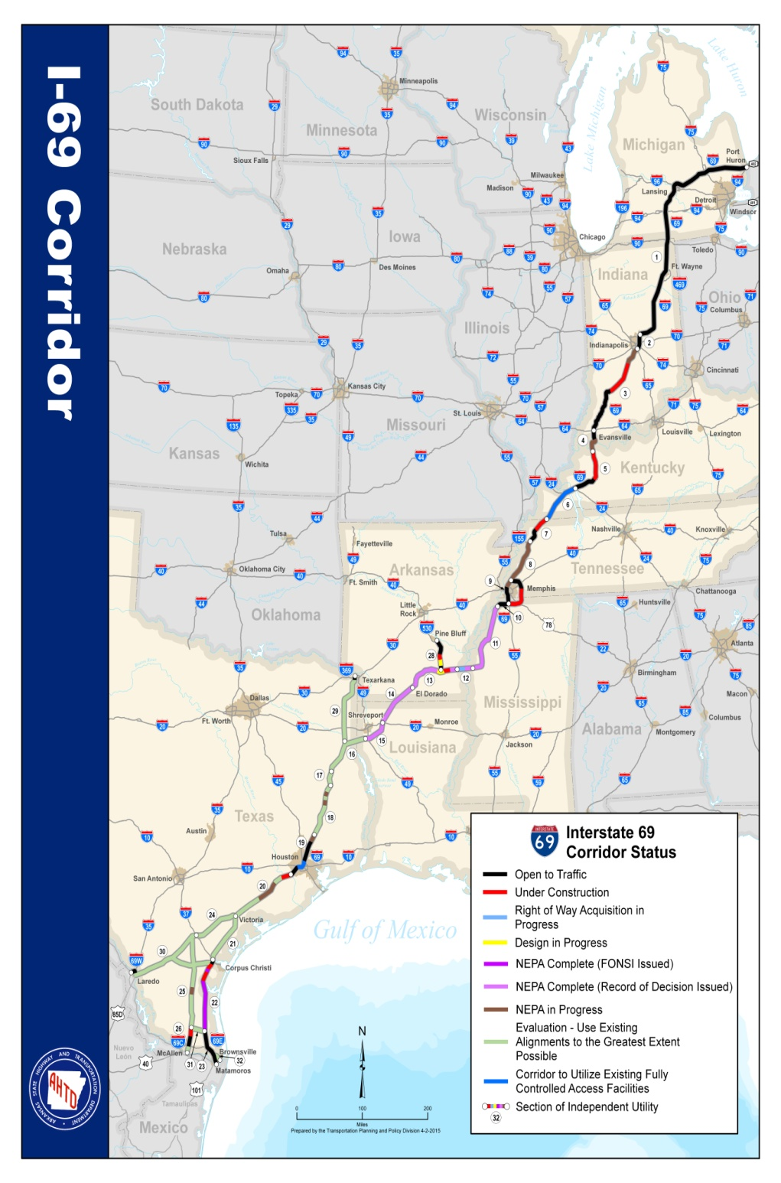
Canada to Mexico
2,730 miles
Estimated Cost to Complete - $30 Billion
Congressionally Designated High Priority Corridors 18 & 20
Includes the I-69 Connector

Slide 22
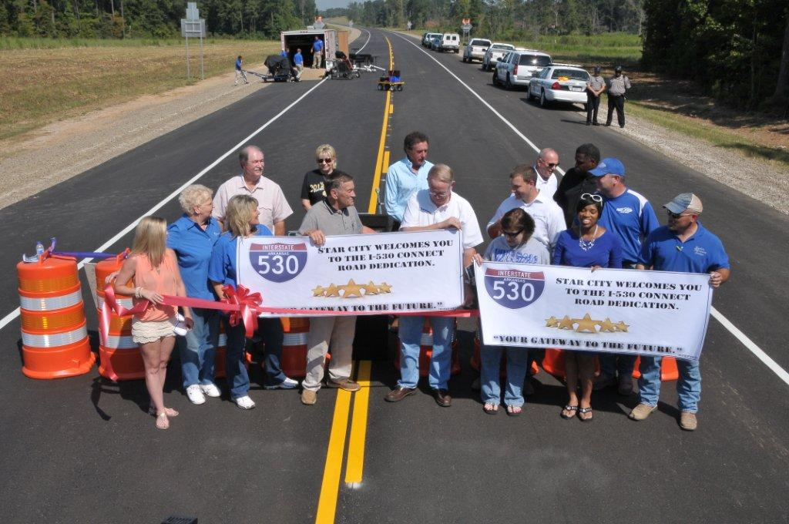
I-69 Connector Funding Summary
Status | Miles | Total ( millions)
Complete | 22.5 | $ 140
Under Construction | 6.5 | $ 35
Scheduled | 2.8 | $ 14
Unfunded | 10.5 | $ 520
Totals | 42.3 | $ 709

Slide 23
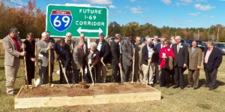
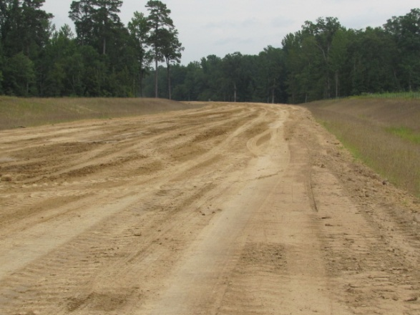
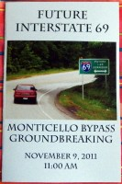
Monticello Bypass

Slide 24
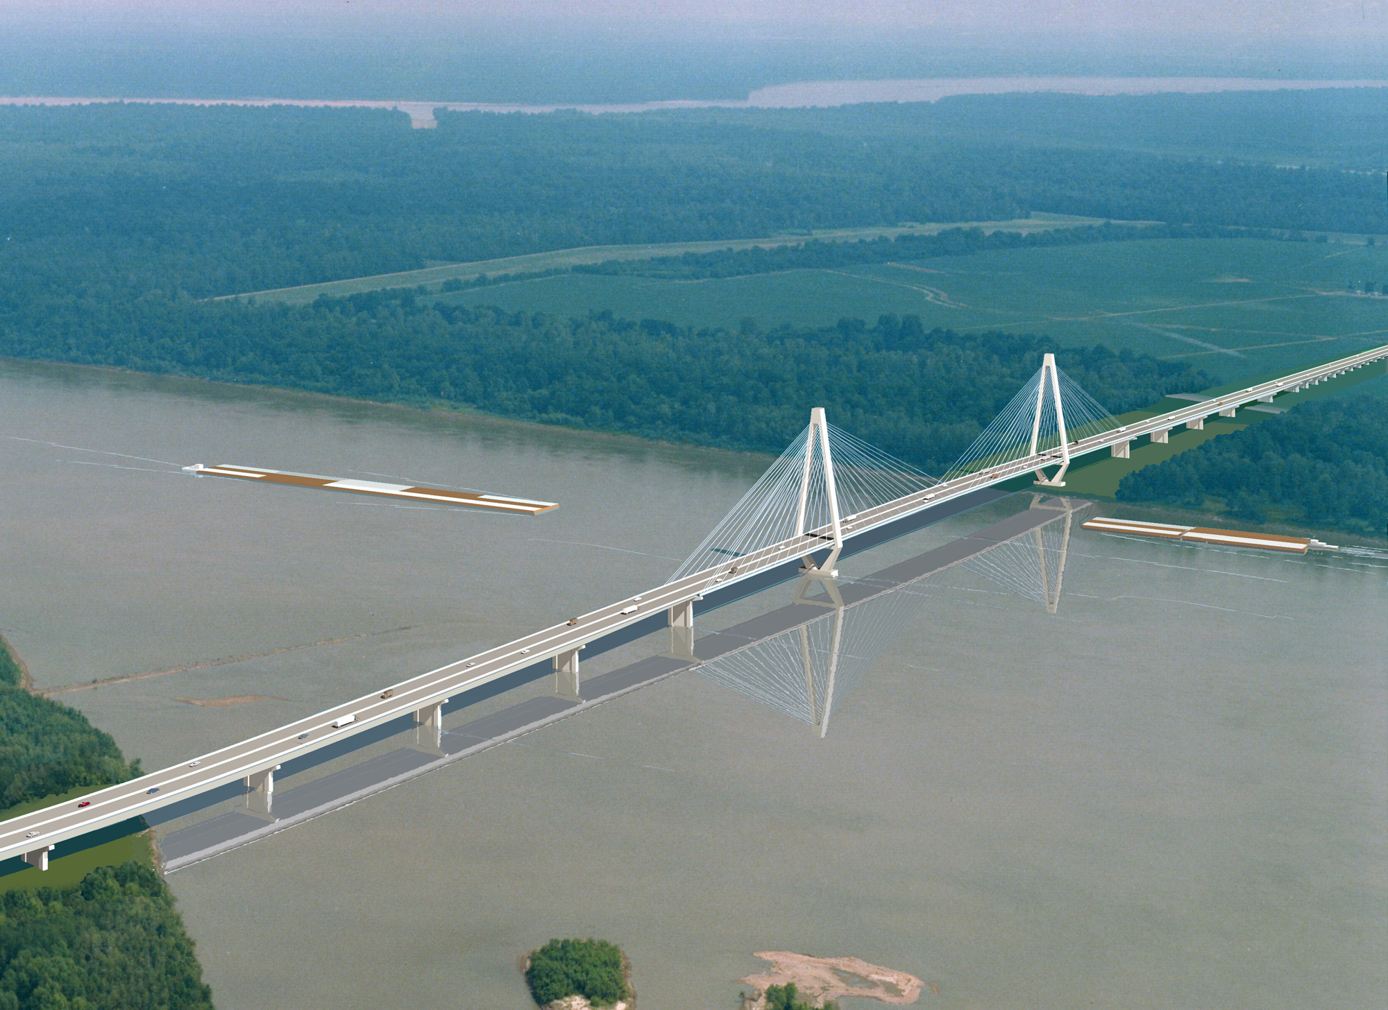
I-69 Great River Bridge
Design Complete
Estimated Cost - $1.3 Billion
Arkansas’ Portion - $910 Million
ROW Acquisition Underway

Slide 25
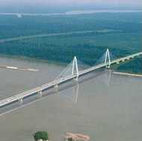
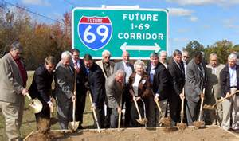
I-69 Funding Summary
Status | Miles | Total (millions)
Complete | - | -
Under Construction | 8.5 | $ 13
Scheduled | 11.3 | $ 79
Unfunded | 122.0 | $ 2,980
Totals | 141.8 | $ 3,072

Slide 26
Mississippi

Slide 27


Mississippi
Interstate 69/269
Update

Slide 28
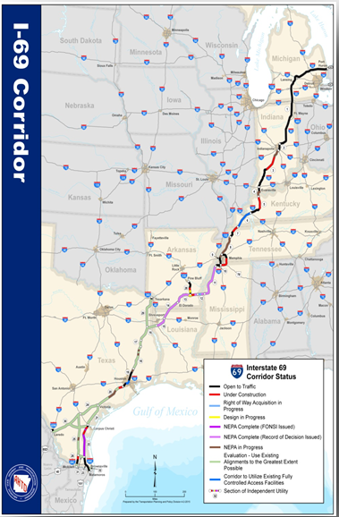



*
Canada to Mexico
2,730 miles
Estimated Cost to Complete - $30 Billion
Congressionally Designated High Priority Corridors 18 & 20
Identified by Sections of Independent Utility (SIUs)
Includes I-69 Connector(s)
* Images courtesy of AHTD

Slide 29
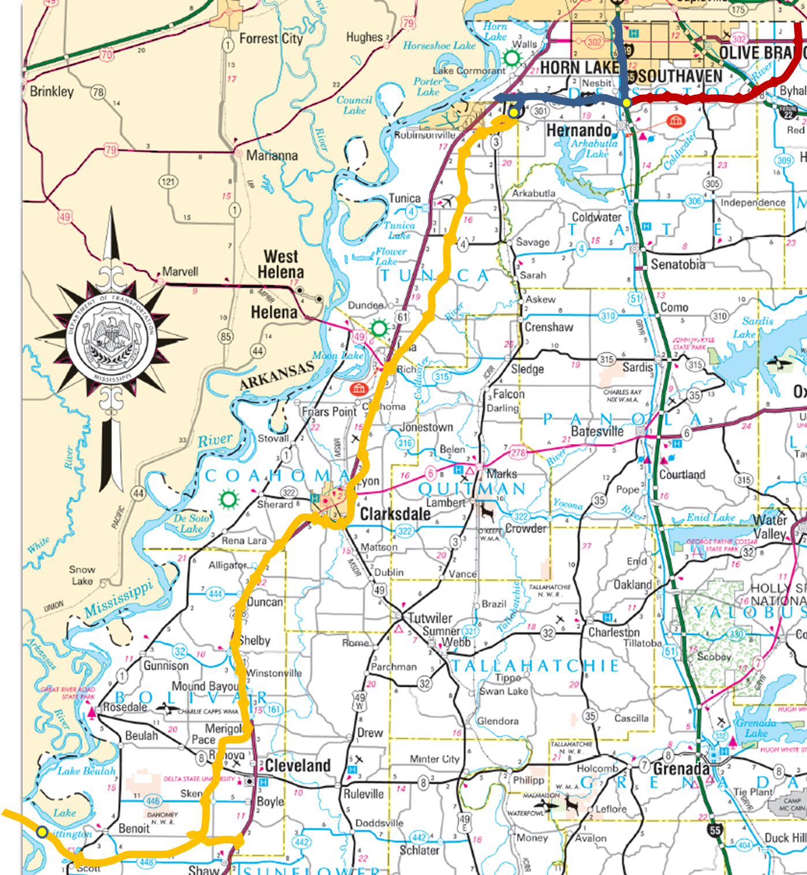

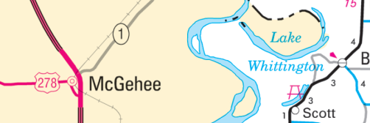
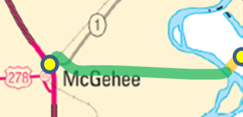

SIU 9
SIU 10
Completed & Open to Traffic
Under Construction
Unfunded Portions
AHTD Portion
SIU Limits
SIU 11
I-69 in Mississippi
SIU 12

Slide 30

Funding
Status | Miles | Total (in millions)
Completed | 39 | $82.0
Under Construction | 26 | $649.4
Unfunded | 113 | $1,827.0
Totals | 178 | $2,558.4

Slide 31
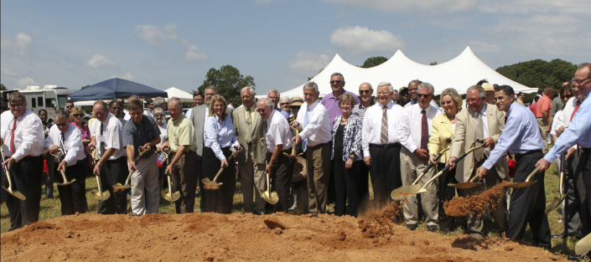
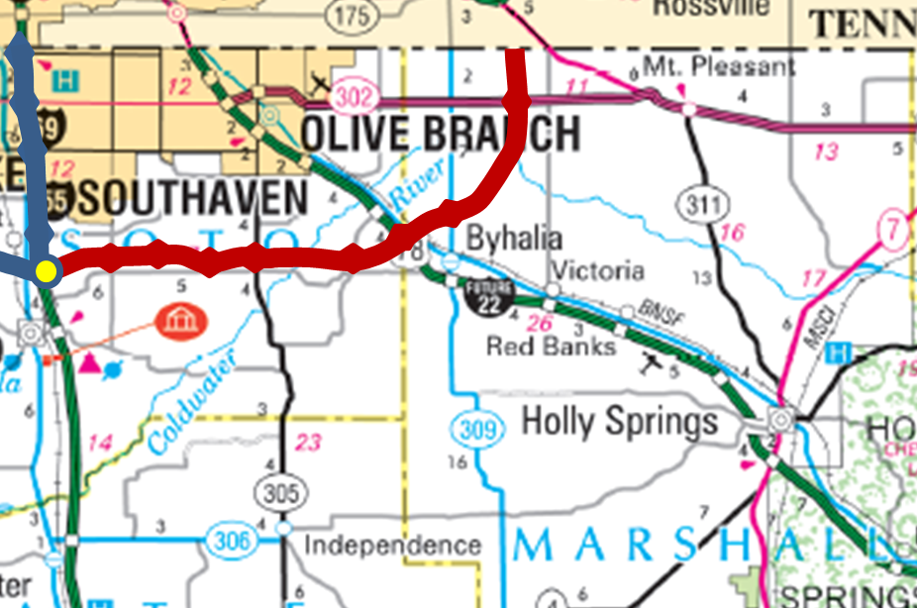
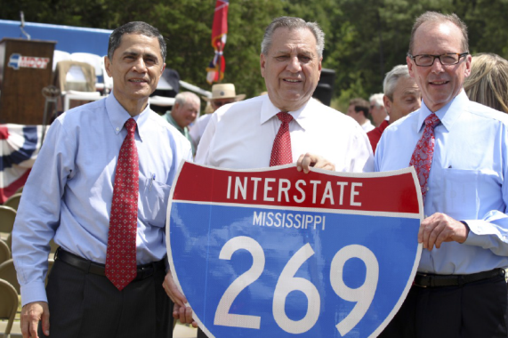
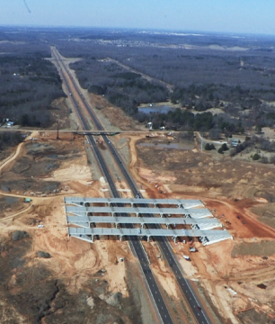
SIU 9

Slide 32
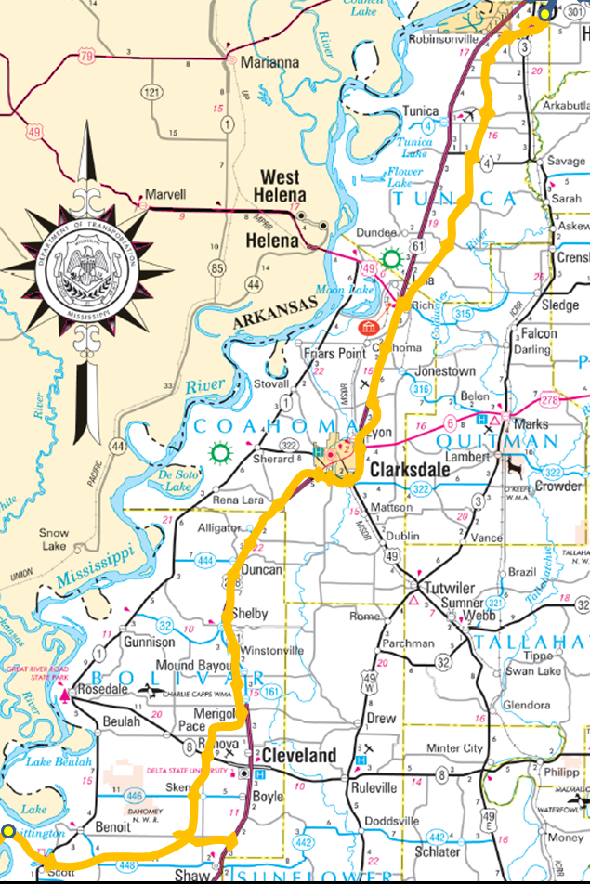
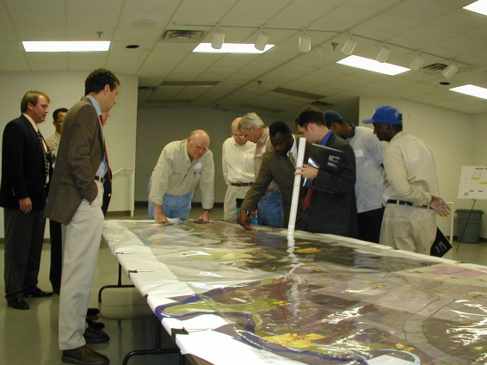
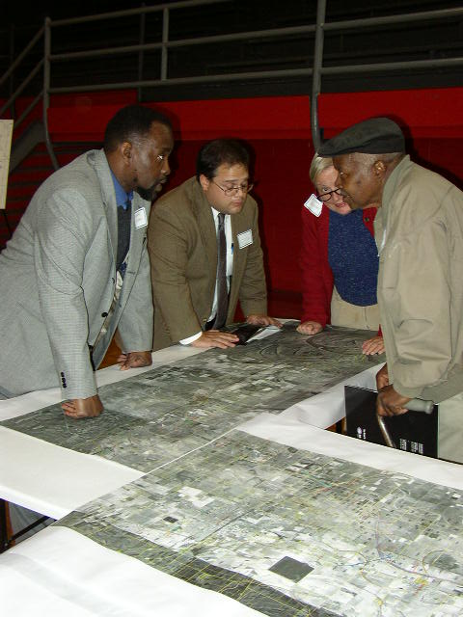
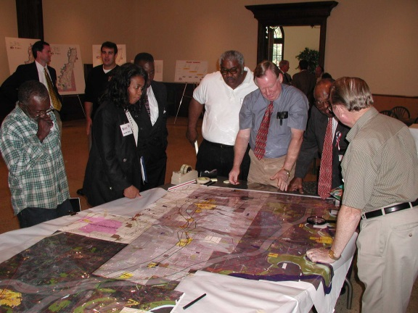
SIU 11
Unfunded Portions SIU Limits

Slide 33
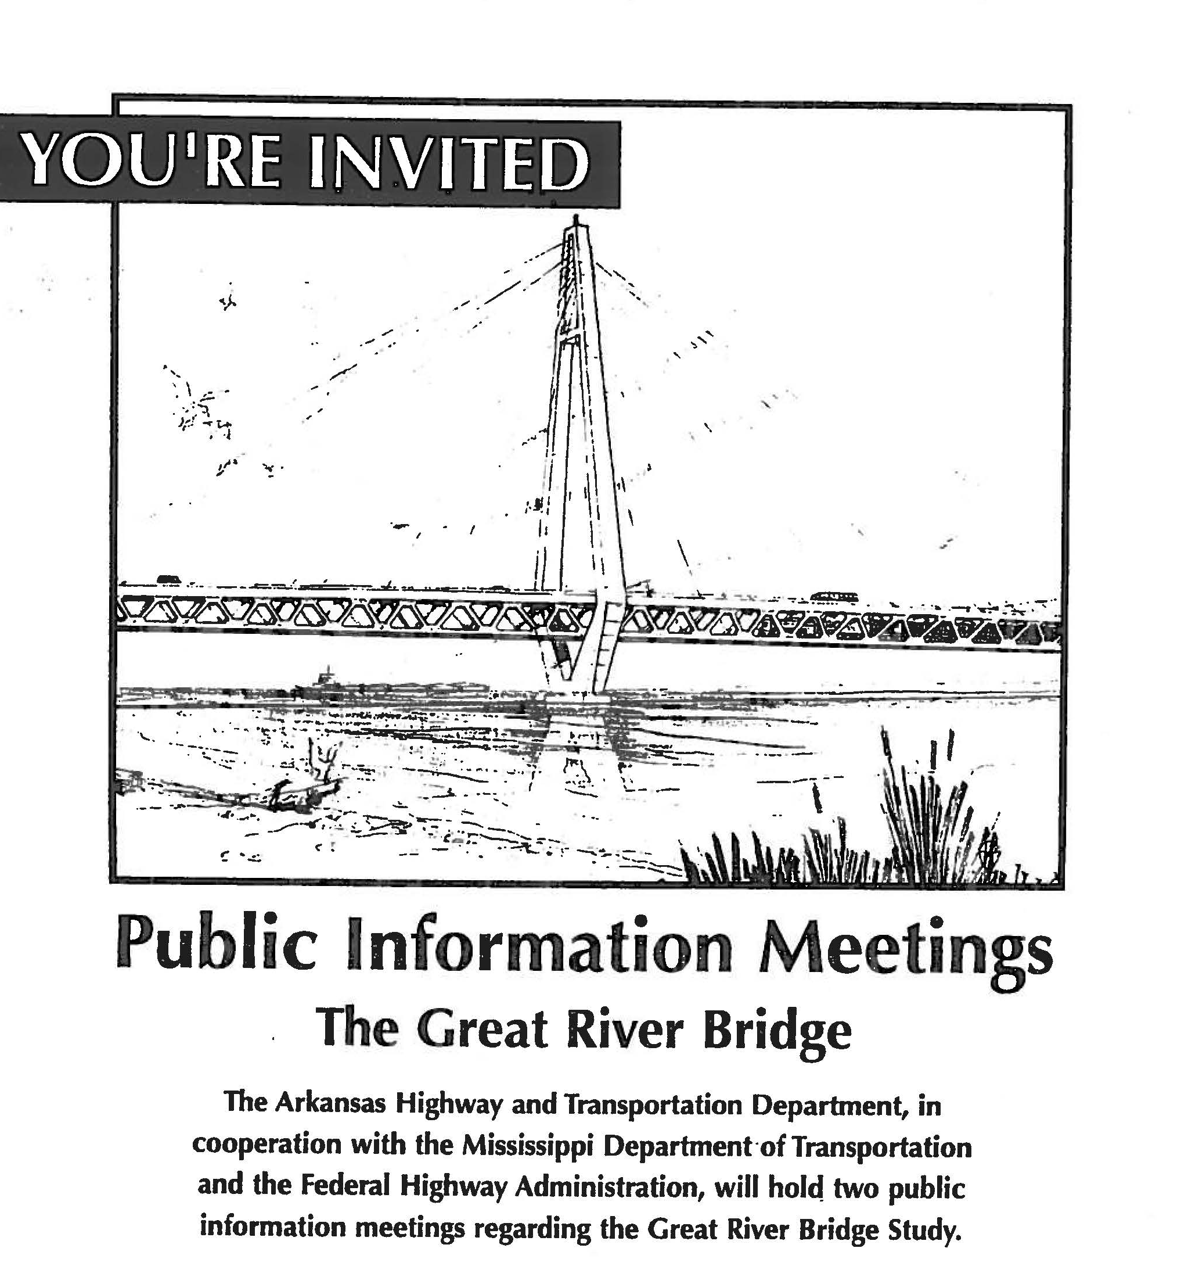
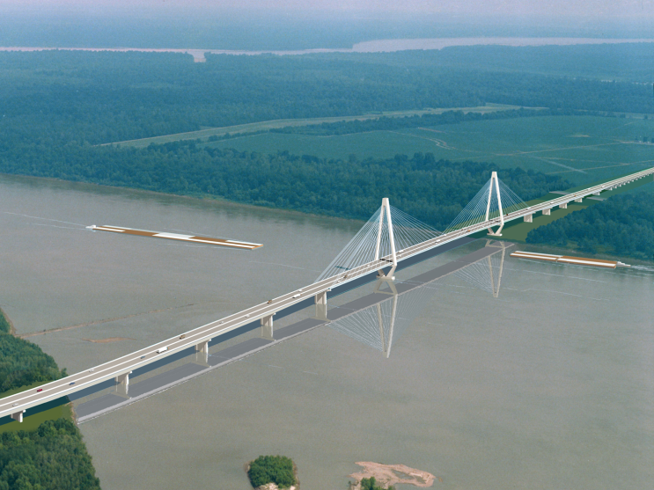
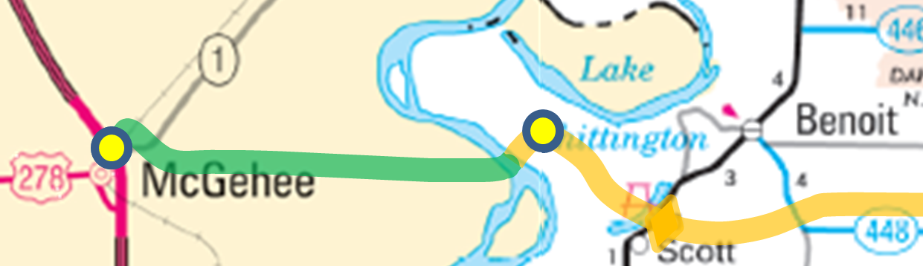
SIU 12
*
*
AHTD Portion Unfunded Portions SIU Limits
* Images courtesy of AHTD

Slide 34
Tennessee

Slide 35
Kentucky

Slide 36

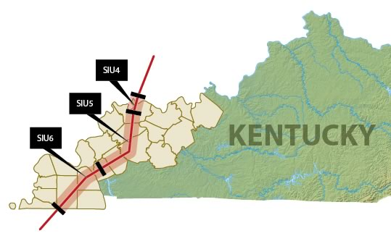
In Kentucky

Slide 37
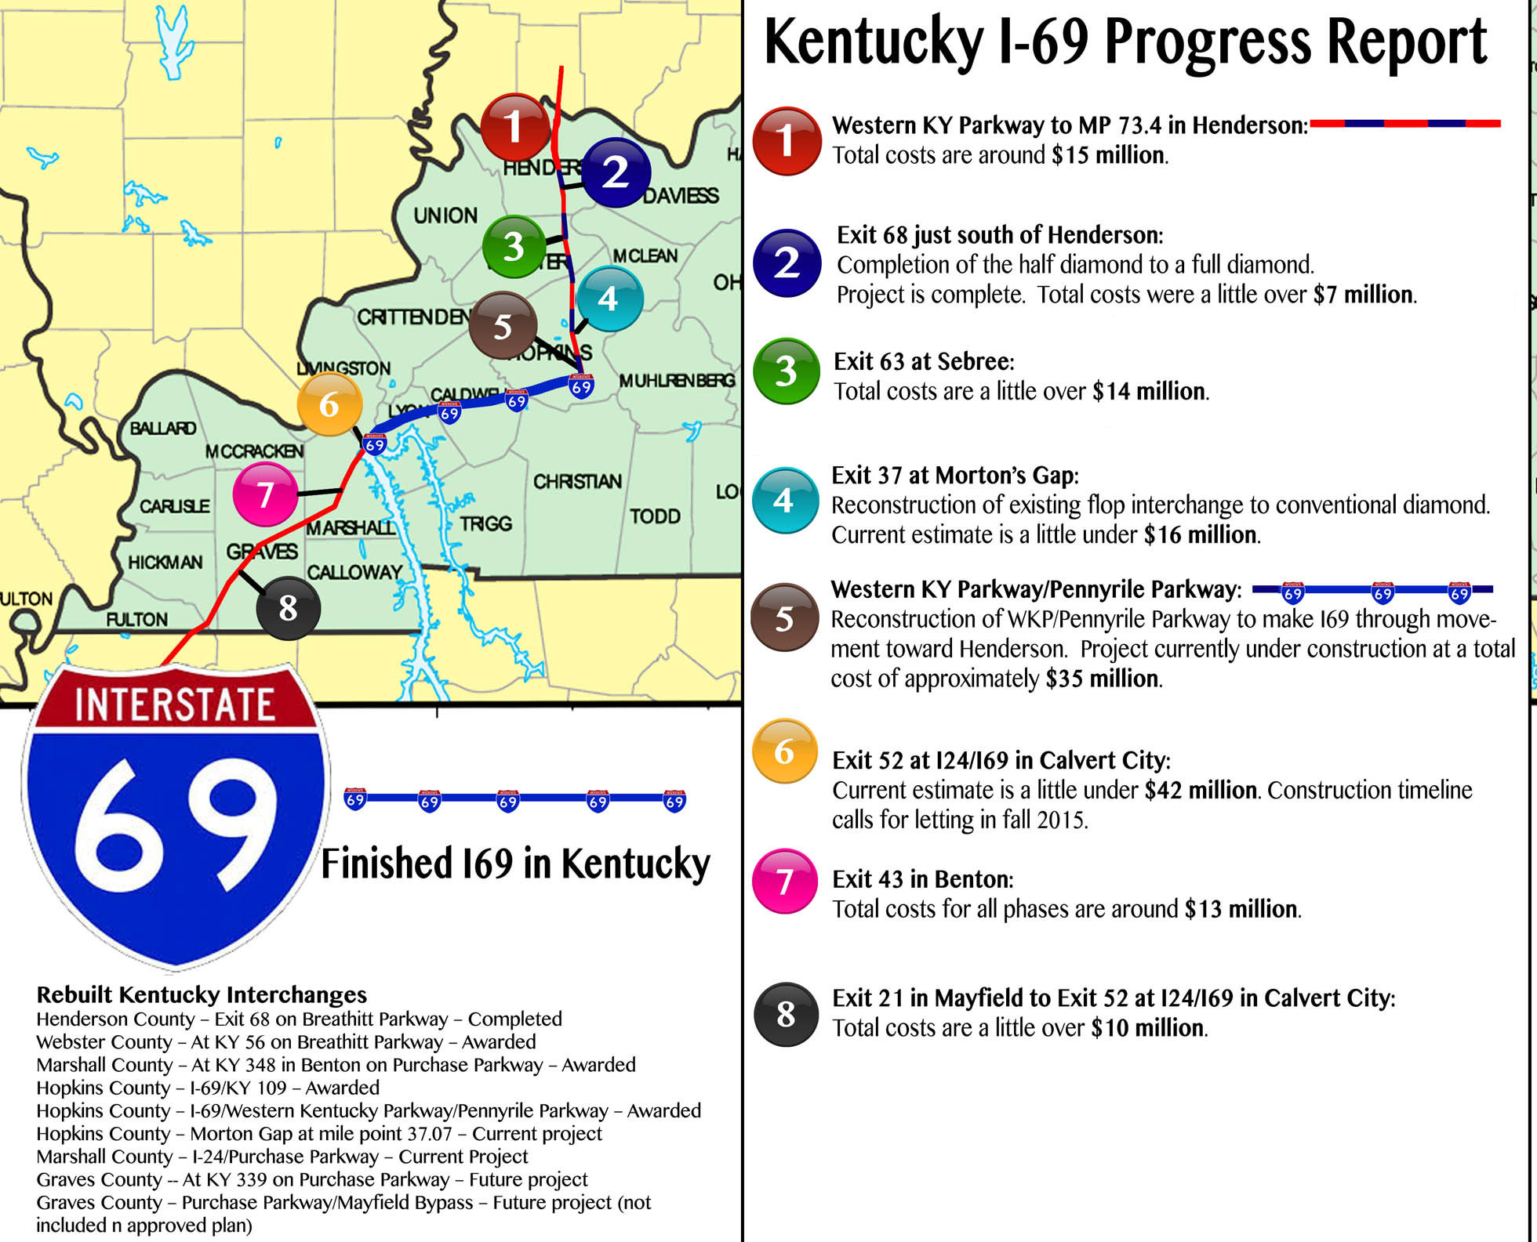

Slide 38
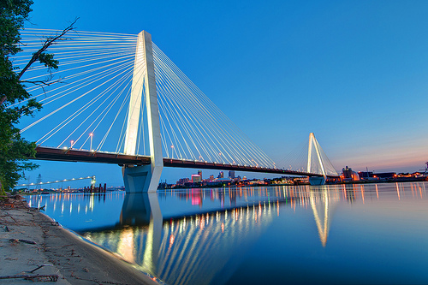

I-69 Ohio River Bridge
2008 estimated cost: $1.4 billion, including nearly 8 miles of approaches and new terrain build.
2014 estimated cost: Approx. $850 million, based on shortened route and cost savings identified by construction firm which built new I-70/Stan Musial Bridge at St. Louis (pictured at right).
INDOT now conducting toll revenue study.

Slide 39
Indiana

Slide 40

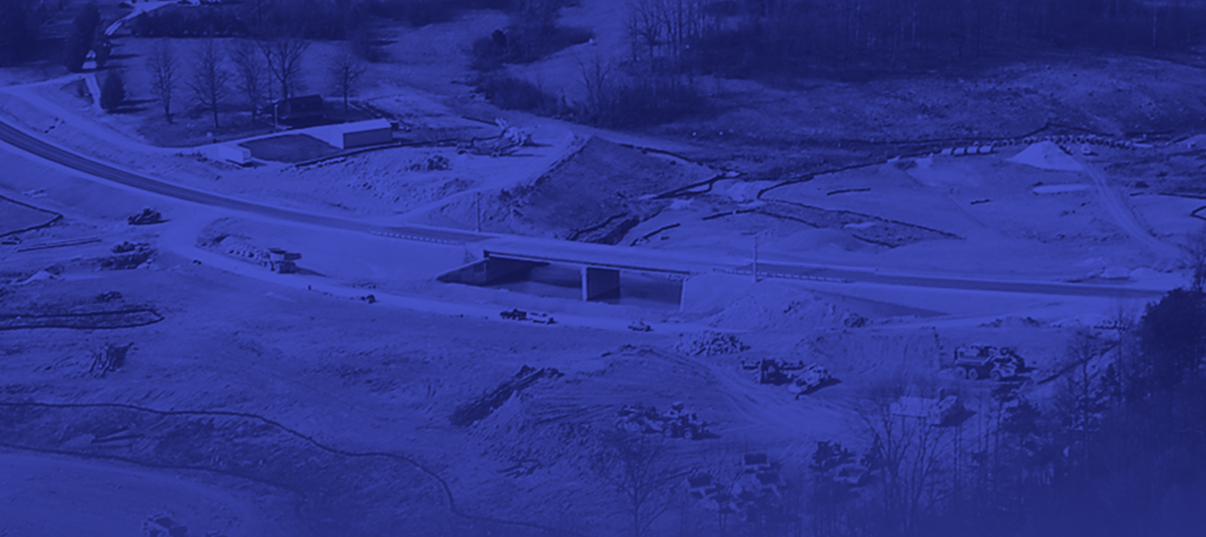

I-69 Indiana
April 22, 2015
James P. Stark
Deputy Commissioner
INDOT

Slide 41
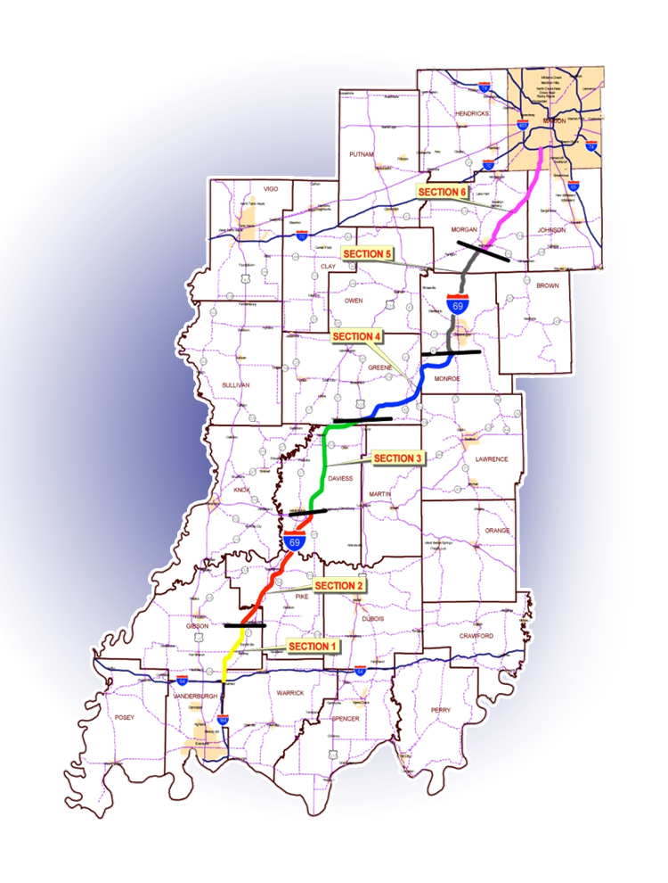
I-69 Project Background
Tier 1 Record of Decision (ROD) granted by FHWA - March 2004
Approved corridor
Approximately 142 miles long
I-64 north of Evansville to I-465 in Indianapolis
Six sections of independent utility identified for detailed Tier 2 studies

Slide 42
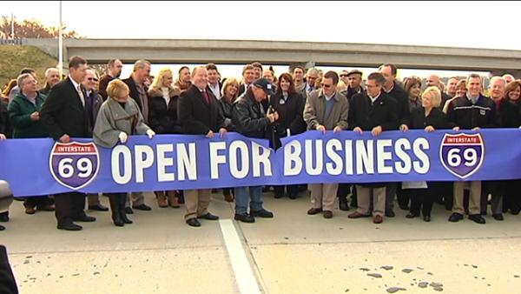
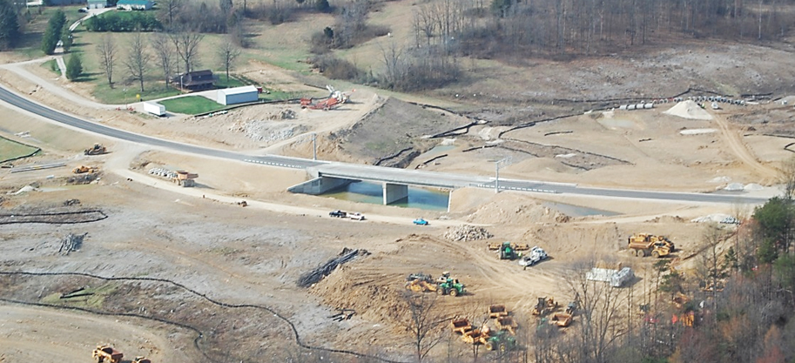
Progress
Sections 1-3
67 miles: I-64 to US 231 near Crane
9 years ahead of original schedule
Open November 2012
Section 4
27 miles: US 231 to SR 37
Links 4-lanes from Evansville to Bloomington
Under construction
Open 2015
SR 45 Interchange Location

Slide 43
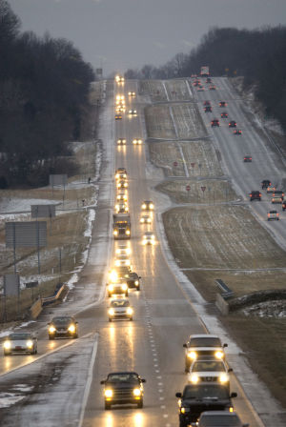
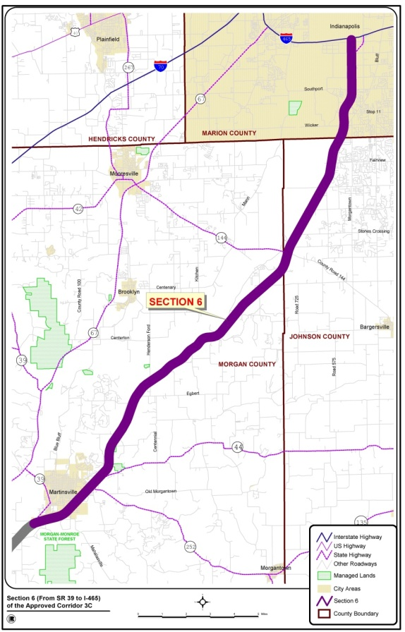
Progress (continued)
Section 5
21 miles: Bloomington to Martinsville
P3 Availability Payment Procurement 2013-2014. Financial close July 2014
Construction began fall 2014
Open late fall 2016
Section 6
26 miles: Martinsville to Indianapolis
“Finish what we started”
Tier 2 NEPA started in October 2014.
Rod expected Fall of 2017

Slide 44


Section 5: Delivery Model
Innovative, availability payment (AP), design-build-finance-operate-maintain (DBFOM) model through Public-Private Agreement
Term of contract for construction + 35 years Operation & Maintenance
Milestone payments during construction
Periodic APs
Non-performance and/or unavailability of facility reduce AP

Slide 45

“Not in My Lifetime”
“For those who said I will never drive on this road
in my lifetime, guess what?…”
September 2009 – Indianapolis Star

Slide 46
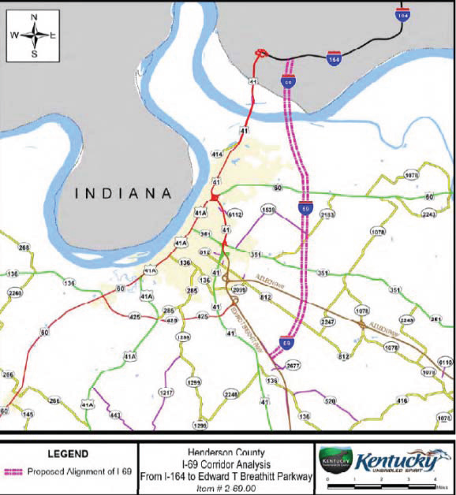
I-69 Bridge Update
Current Status
Blue Ribbon Panel
Recommended projects currently unfunded
Bridge on Tier 1 list
INDOT conducting traffic &
revenue study
Completed in next 12 months
Not environmental study
Results will drive next steps – P3 viable?

Slide 47
Michigan

Slide 48

Regional Update
Janice Karcher, VP – Economic Development
Flint & Genesee Chamber of Commerce
Paul Brake, Chairman
I-69 International Trade Corridor
Next Michigan Development Corp
April 22, 2015

Slide 49
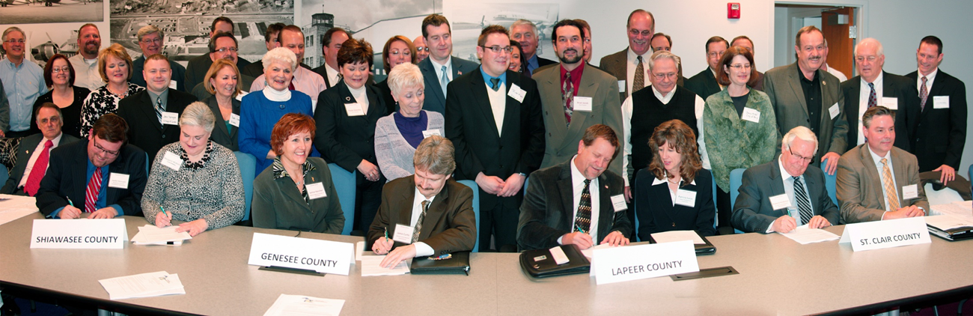
I-69 International Trade Corridor
Next Michigan Development Corporation
Largest of five regional groups – 35 municipal members
Focus on multi-modal development
Tax abatements, tax-free zones, and TIFA districts
Celebrates regional impact of investment projects
Supported 4-county EDA CEDS funding; 7-county
Prosperity Plan funding; 13-county IMCP designation
2014 IEDC Bronze Excellence Award

Slide 50



I-69 Status in Michigan

Slide 51

I-69 Status in Michigan
Primary Freight Network
First 122 Miles from Blue Water Bridge to Lansing Omitted
I-75 and I-94 Connections to I-69 Omitted
Region Waged Significant Public Input Campaign
Numerous DC Conversations Addressing Shortfall In Plan

Slide 52

I-69 Status in Michigan
Blue Water Bridge
Between Port Huron, Michigan and Sarnia, Ontario
2nd Busiest Commercial Vehicle Crossing between 2 Countries

Slide 53


I-69 Status in Michigan
Blue Water Bridge Plaza & Corridor Improvements
Completed: I-96/I-69 Corridor, Black River Bridge - $90 million
Now: I-96/I-69 Interchange & Welcome Center – $81.5 million
Proposed: 56-Acre Bridge Plaza and Corridor Expansion
Counter-Proposal: 34-acre Plaza Expansion – Awaiting Funding

Slide 54
A Freight Corridor Connecting the American Heartland

